Slide 1
Inference in First-Order Logic

Slide 2
Contents
Reducing FO inference to propositional inference
Unification
Generalized Modus Ponens
Forward and Backward Chaining
Logic Programming
Resolution

Slide 3
Necessary Algorithms
We already know enough to implement TELL (although maybe not efficiently)
But how do we implement ASK?
Recall 3 cases
  Direct matching
  Finding a proof (inference)
  Finding a set of bindings (unification)

Slide 4
Inference with Quantifiers
Universal Instantiation:
  Given ∀x, person(x) ⇒ likes(x, McDonalds)
  Infer person(John) ⇒ likes(John, McDonalds)
Existential Instantiation:
  Given ∃x, likes(x, McDonalds)
  Infer ⇒ likes(S1, McDonalds)
  S1 is a “Skolem Constant” that is not found anywhere else in the KB and refers to (one of) the indviduals that likes McDonalds.

Slide 5

Universal Instantiation
Every instantiation of a universally quantified sentence is entailed by it:
  for any variable v and ground term g
    ground term…a term without variables
Example:
  ∀x King(x) ∧ Greedy(x) ⇒ Evil(x) yields
    King(John) ∧ Greedy(John) ⇒ Evil(John)
    King(Richard) ∧ Greedy(Richard) ⇒ Evil(Richard)
    King(Father(John)) ∧ Greedy(Father(John) ⇒ Evil(Father(John))
    …

Slide 6

Existential Instantiation
For any sentence α, variable v, and constant k that does not appear in the KB:
Example:
  ∃x Crown(x) ∧ OnHead(x, John) yields:
    Crown(C₁) ∧ OnHead(C₁, John)
    provided C₁ is a new constant (Skolem)

Slide 7
Existential Instantiation
UI can be applied several times to add new sentences
  The KB is logically equivalent to the old
EI can be applied once to replace the existential sentence
  The new KB is not equivalent to the old but is satisfiable iff the old KB was satisfiable

Slide 8
Reduction to Propositional Inference
Use instantiation rules to create relevant propositional facts in the KB, then use propositional reasoning
Problems:
  May generate infinite sentences when it cannot prove
  Will generate many irrelevant sentences along the way!

Slide 9
Reduction to Propositional Inference
Suppose the KB had the following sentence
  ∀x King(x) ∧ Greedy(x) ⇒ Evil(x)
  King(John)
  Greedy(John)
  Brother(Richard, John)

Slide 10
Reduction to Propositional Inference
Instantiating the universal sentence in all possible ways…
  King(John) ∧ Greedy(John) ⇒ Evil(John)
  King(Richard) ∧ Greedy(Richard) ⇒ Evil(Richard)
  King(John)
  Greedy(John)
  Brother(Richard, John)
The new KB is propositionalized: propositional symbols are…
  King(John), Greedy(John), Evil(John), King(Richard), etc…

Slide 11
Problems with Propositionalization
Propositionalization tends to generate lots of irrelevant sentences
Example
    ∀x King(x) ∧ Greedy(x) ⇒ Evil(x)
    King(John)
    ∀y Greedy(y)
    Brother(Richard, John)
  Obvious that Evil(John) is true, but the fact Greedy(Richard) is irrelevant
With p k-ary predicates and n constants, there are p * n^{k} instantiations!!!

Slide 12
Unification
Unification: The process of finding all legal substitutions that make logical expressions look identical

Slide 13
Unification
We can get the inference immediately if we can find a substitution θ such that King(x) and Greedy(x) match King(John) and Greedy(y)
θ = {x/John, y/John} works
Unify(α,β) = θ if α θ = β θ

Slide 14
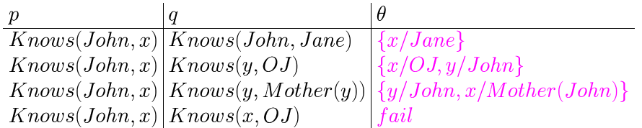
Unification

Slide 15

Generalized Modus Ponens
This is a general inference rule for FOL that does not require instantiation
Given:
  p1’, p2’ … pn’ (p1 ∧ … pn) ⇒ q
  Subst(θ, pi’) = subst(θ, pi) for all p
Conclude:
  Subst(θ, q)

Slide 16
GMP in “CS terms”
Given a rule containing variables
If there is a consistent set of bindings for all of the variables of the left side of the rule (before the arrow)
Then you can derive the result of substituting all of the same variable bindings into the right side of the rule

Slide 17
GMP Example
∀x, Parent(x,y) ∧ Parent(y,z) ⇒ GrandParent(x,z)
Parent(James, John), Parent(James, Richard), Parent(Harry, James)
We can derive:
  GrandParent(Harry, John), bindings:
  ((x Harry) (y James) (z John)
  GrandParent(Harry, Richard), bindings:
  ((x Harry) (y James) (z Richard)

Slide 18
Forward Chaining
Forward Chaining
  Start with atomic sentences in the KB and apply Modus Ponens in the forward direction, adding new atomic sentences, until no further inferences can be made.

Slide 19
Forward Chaining
Given a new fact, generate all consequences
Assumes all rules are of the form
  C1 and C2 and C3 and…. --> Result
Each rule & binding generates a new fact
This new fact will “trigger” other rules
Keep going until the desired fact is generated
(Semi-decidable as is FOL in general)

Slide 20
FC: Example Knowledge Base
The law says that it is a crime for an American to sell weapons to hostile nations. The country Nono, an enemy America, has some missiles, and all of its missiles were sold to it by Col. West, who is an American.
Prove that Col. West is a criminal.

Slide 21
FC: Example Knowledge Base
…it is a crime for an American to sell weapons to hostile nations
  American(x) ∧Weapon(y) ∧Sells(x,y,z) ∧Hostile(z) ⇒ Criminal(x)
Nono…has some missiles
  ∃x Owns(Nono, x) ∧ Missiles(x)
  Owns(Nono, M₁) and Missle(M₁)
…all of its missiles were sold to it by Col. West
  ∀x Missle(x) ∧ Owns(Nono, x) ⇒ Sells( West, x, Nono)
Missiles are weapons
  Missle(x) ⇒ Weapon(x)

Slide 22
FC: Example Knowledge Base
An enemy of America counts as “hostile”
  Enemy( x, America ) ⇒ Hostile(x)
Col. West who is an American
  American( Col. West )
The country Nono, an enemy of America
  Enemy(Nono, America)

Slide 23
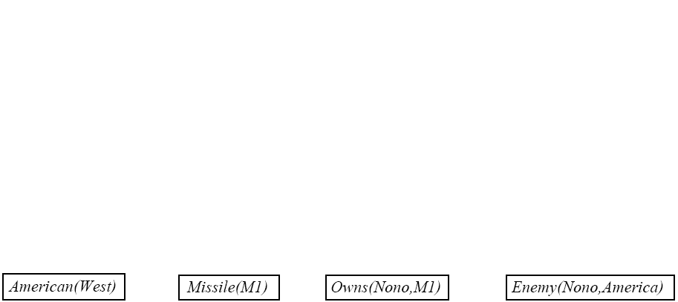
FC: Example Knowledge Base

Slide 24
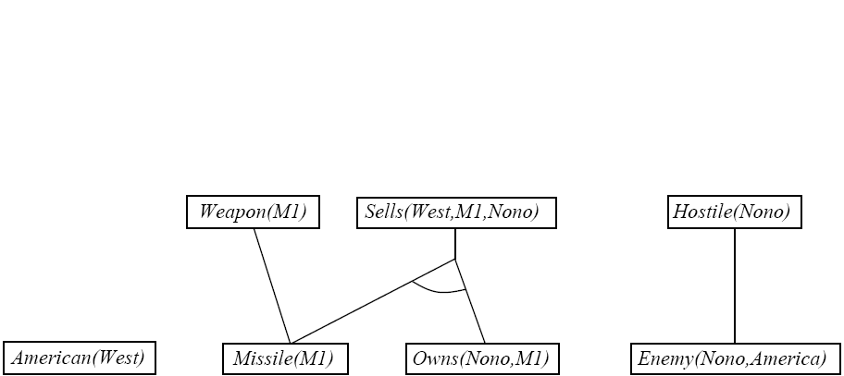
FC: Example Knowledge Base

Slide 25
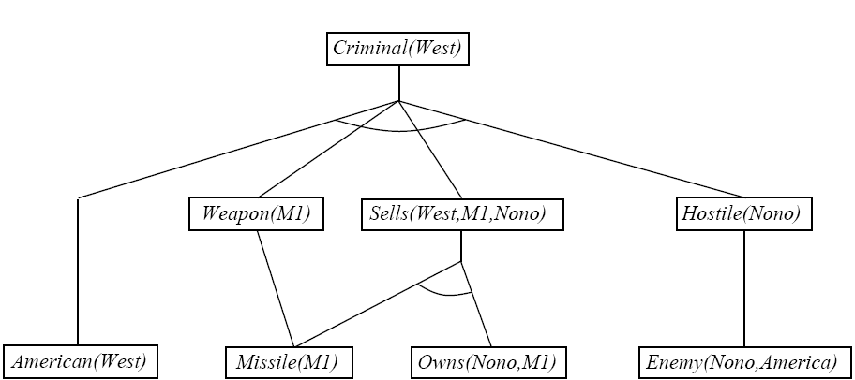
FC: Example Knowledge Base

Slide 26
Efficient Forward Chaining
Order conjuncts appropriately
  E.g. most constrained variable
Don’t generate redundant facts; each new fact should depend on at least one newly generated fact.

Slide 27
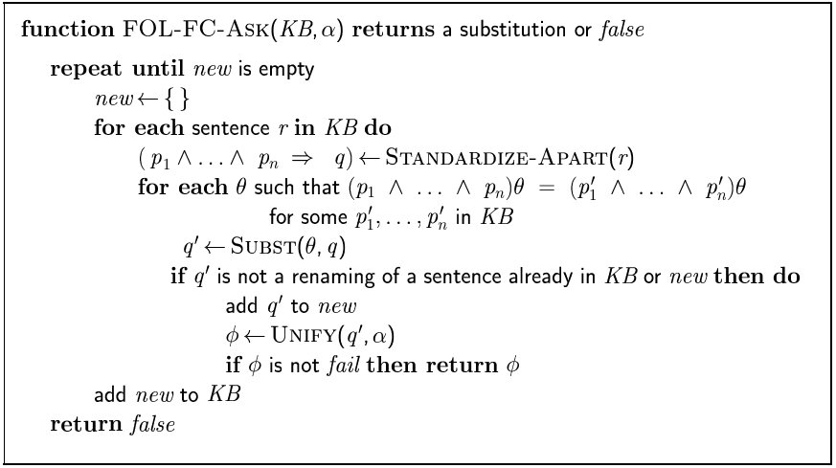
Forward Chaining Algorithm

Slide 28
Backward Chaining
Consider the item to be proven a goal
Find a rule whose head is the goal (and bindings)
Apply bindings to the body, and prove these (subgoals) in turn
If you prove all the subgoals, increasing the binding set as you go, you will prove the item.
Logic Programming (cprolog, on CS)

Slide 29

Backward Chaining Example

Slide 30
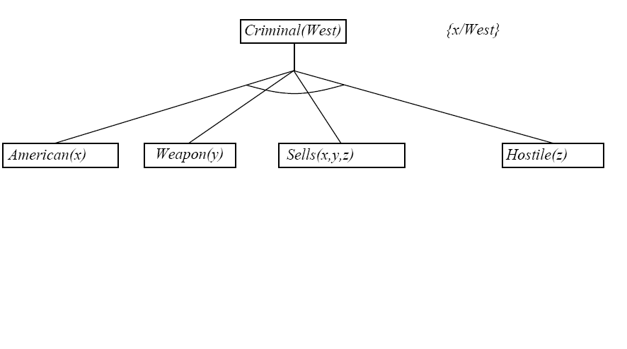
Backward Chaining Example

Slide 31
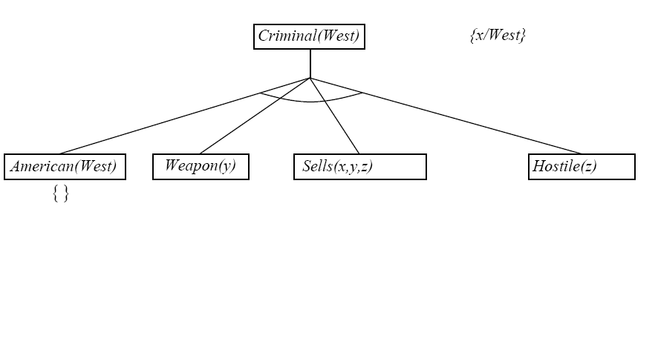
Backward Chaining Example

Slide 32
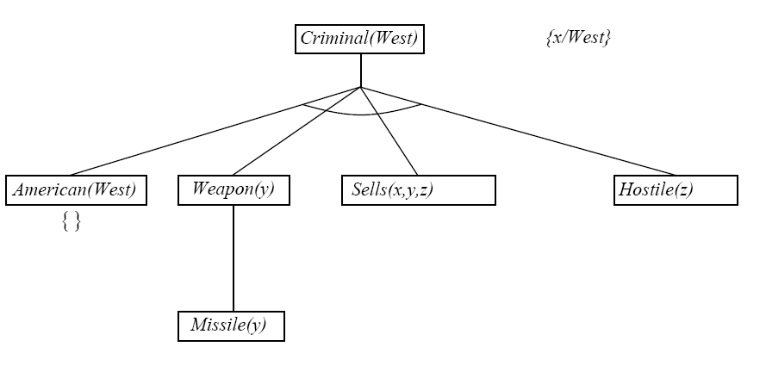
Backward Chaining Example

Slide 33
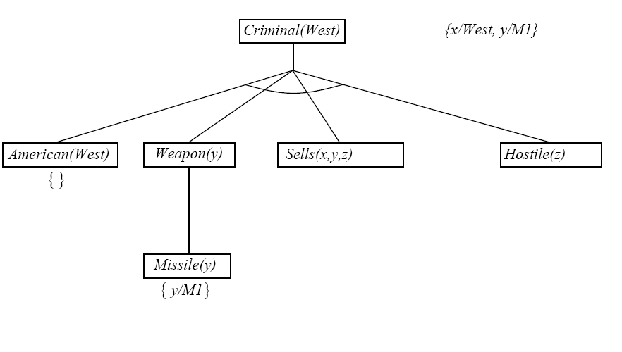
Backward Chaining Example

Slide 34
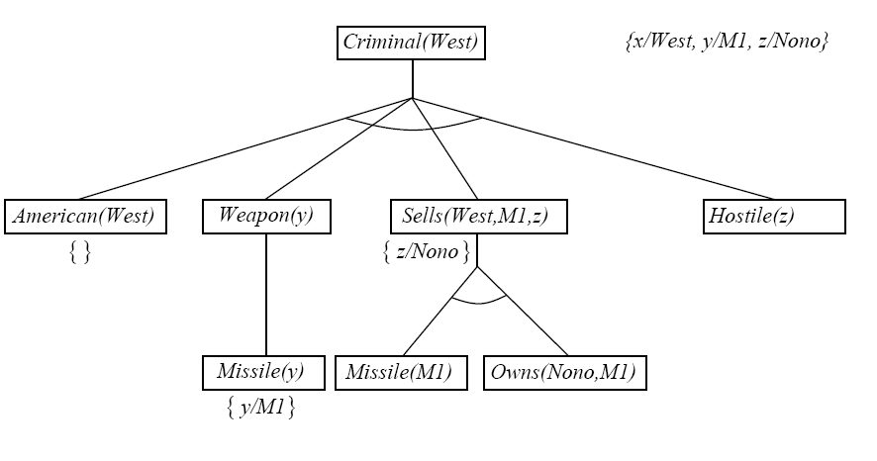
Backward Chaining Example

Slide 35
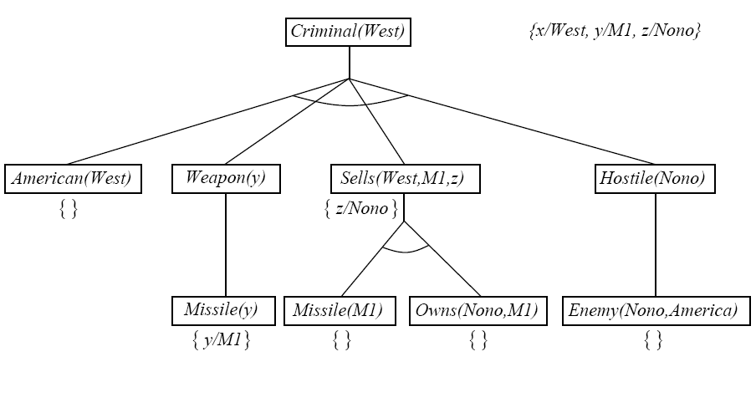
Backward Chaining Example

Slide 36
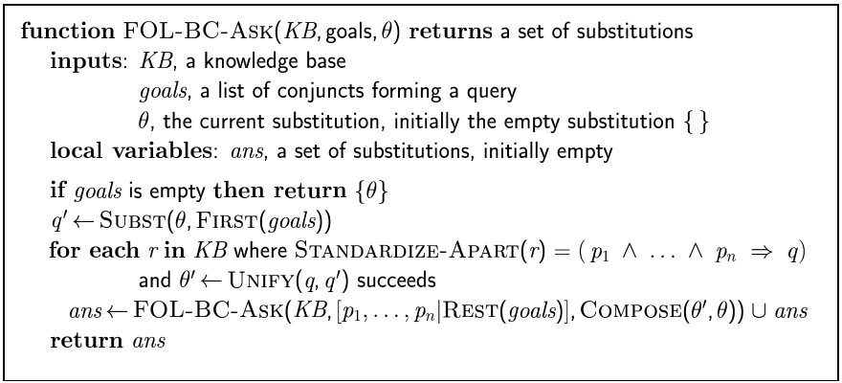
Backward Chaining Algorithm

Slide 37
Properties of Backward Chaining
Depth-first recursive proof search: space is linear in size of proof
Incomplete due to infinite loops
  Fix by checking current goal with every subgoal on the stack
Inefficient due to repeated subgoals (both success and failure)
  Fix using caching of previous results (extra space)
Widely used without improvements for logic programming

Slide 38
Inference Methods
Unification (prerequisite)
Forward Chaining
Backward Chaining
  Logic Programming (Prolog)
Resolution
  Transform to CNF
  Generalization of Prop. Logic resolution

Slide 39
Resolution
Convert everything to CNF
Resolve, with unification
If resolution is successful, proof succeeds
If there was a variable in the item to prove, return variable’s value from unification bindings

Slide 40
Resolution (Review)
Resolution allows a complete inference mechanism (search-based) using only one rule of inference
Resolution rule:
  Given: P₁ ∨ P₂ ∨ P_{3 …}∨ P_{n,} and ¬P₁ ∨ Q_{1 …}∨ Q_{m}
  Conclude: P₂ ∨ P_{3 …}∨ P_{n} ∨ Q_{1 …}∨ Q_{m}
  Complementary literals P₁ and ¬P₁ “cancel out”
To prove a proposition F by resolution,
  Start with ¬F
  Resolve with a rule from the knowledge base (that contains F)
  Repeat until all propositions have been eliminated
  If this can be done, a contradiction has been derived and the original proposition F must be true.

Slide 41
Propositional Resolution Example
Rules
  Cold and precipitation -> snow
    ¬cold ∨ ¬precipitation ∨ snow
  January -> cold
    ¬January ∨ cold
  Clouds -> precipitation
    ¬clouds ∨ precipitation
Facts
  January, clouds
Prove
  snow

Slide 42
Propositional Resolution Example
¬snow
¬cold ∨ ¬precipitation ∨ snow
¬January ∨ cold
¬cold ∨ ¬precipitation
¬January ∨ ¬precipitation
¬clouds ∨ precipitation
January
¬January ∨ ¬clouds
¬clouds
clouds

Slide 43
Resolution Theorem Proving (FOL)
Convert everything to CNF
Resolve, with unification
  Save bindings as you go!
If resolution is successful, proof succeeds
If there was a variable in the item to prove, return variable’s value from unification bindings

Slide 44
Converting to CNF
Replace implication (A ⇒ B) by ¬A ∨ B
Move ¬ “inwards”
  ¬∀x P(x) is equivalent to ∃x ¬P(x) & vice versa
Standardize variables
  ∀x P(x) ∨ ∀x Q(x) becomes ∀x P(x) ∨ ∀y Q(y)
Skolemize
  ∃x P(x) becomes P(A)
Drop universal quantifiers
  Since all quantifiers are now ∀, we don’t need them
Distributive Law

Slide 45
Convert to FOPL, then CNF
John likes all kinds of food
Apples are food.
Chicken is food.
Anything that anyone eats and isn’t killed by is food.
Bill eats peanuts and is still alive.
Sue eats everything Bill eats.

Slide 46
Prove Using Resolution
John likes peanuts.
Sue eats peanuts.
Sue eats apples.
What does Sue eat?
  Translate to Sue eats X
  Result is a valid binding for X in the proof

Slide 47
Another Example
Steve only likes easy courses
Science courses are hard
All the courses in the basket weaving department are easy
BK301 is a basket weaving course
What course would Steve like?

Slide 48
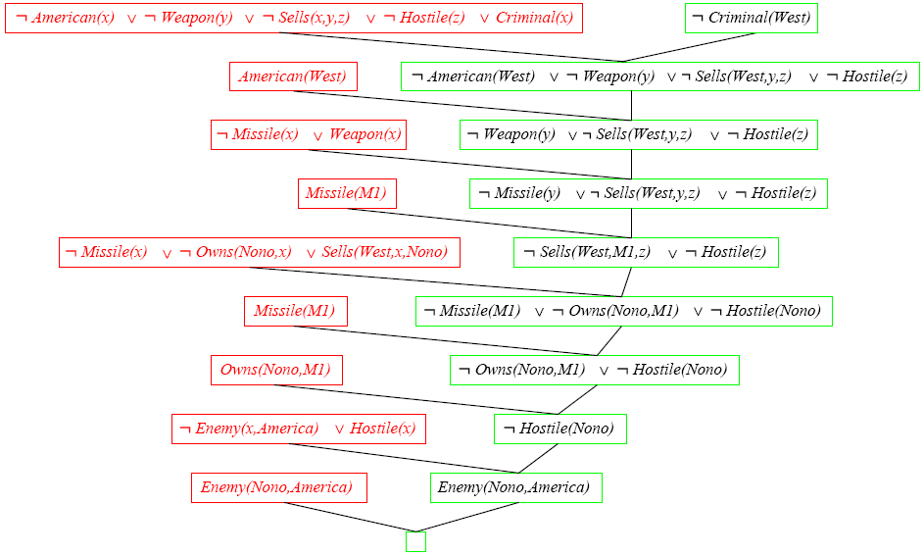
Another Resolution Example

